Slide 1

MOVIE COMMENT SENTIMENT ANALYSIS PROJECT
Uğur Selim ÖZEN
03/16/2022

Slide 2
problem
methodology
Classifying user’s comment that made for IMDB movies.
Writing/Reading Dataset with MongoDB
Data Cleaning & Data Processing
Data Visualization for EDA via Plotly
Different NLP Techniques
Model Building & Evaluation
Streamlit App & Deployment

Slide 3






UTILIZED TECHNOLOGIES
Dataset Overview
▪ Reviews : 573913
▪ Target1 : Sentiment
▪ Target2 : is_spoiler
▪ Data Size : ~ 900 MB

Slide 4
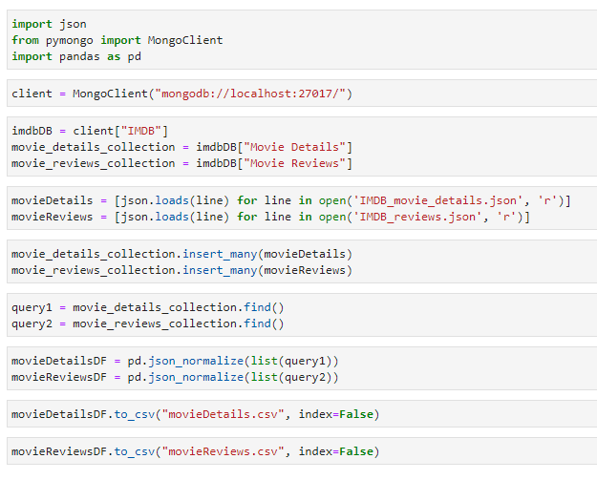
WRITING & READING DATASET FROM MONGODB

Slide 5
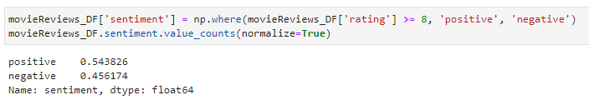
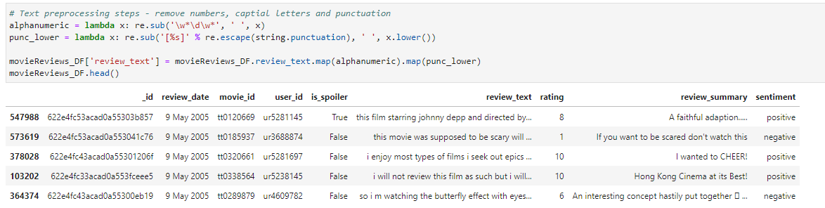
Data Cleaning & Data Processing

Slide 6
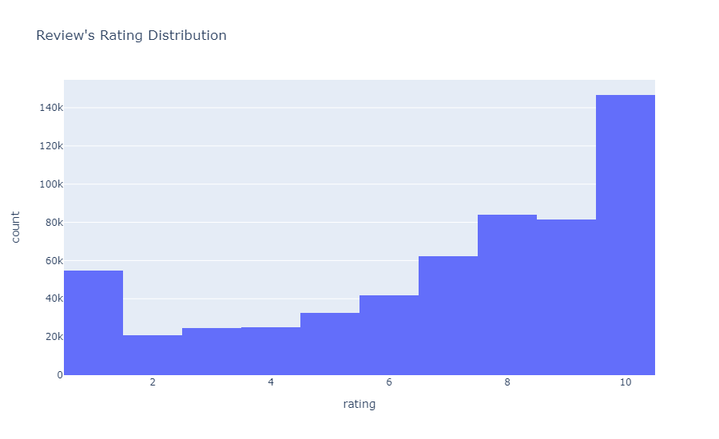
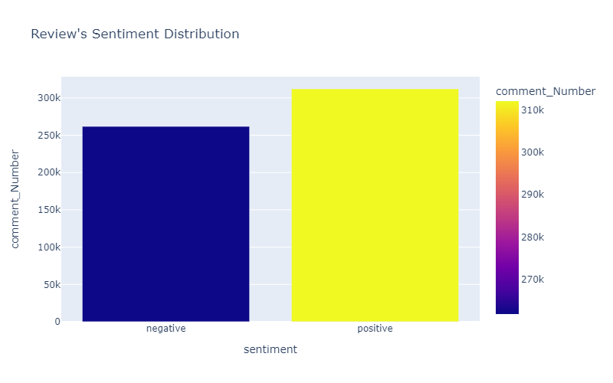
Data VIsualIzatIon for EDA vIa Plotly

Slide 7
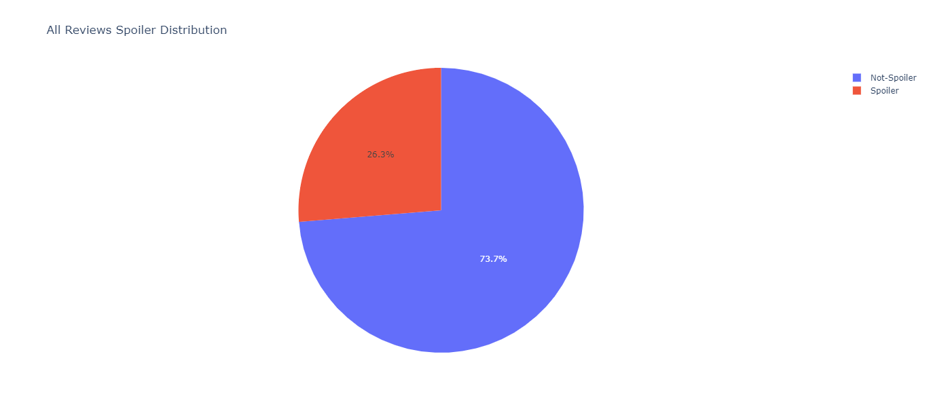
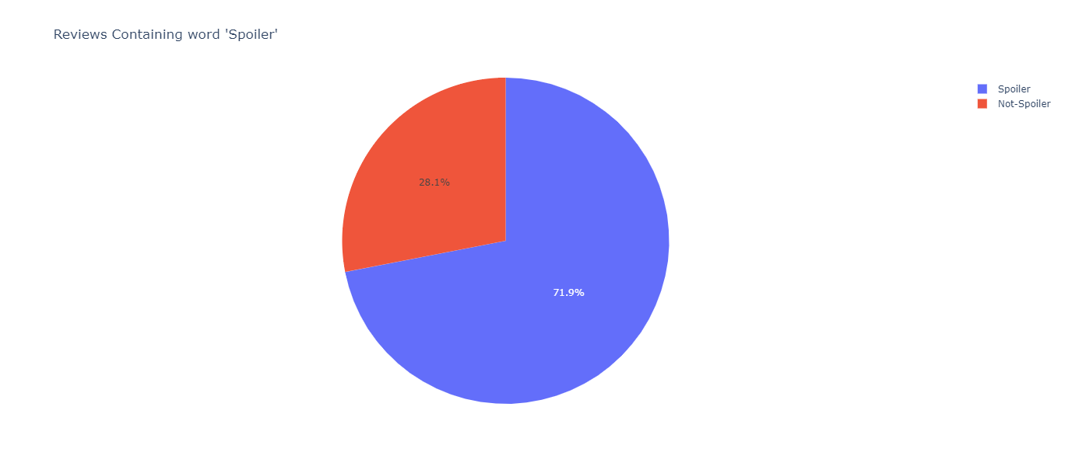
Data VIsualIzatIon for EDA vIa Plotly

Slide 8
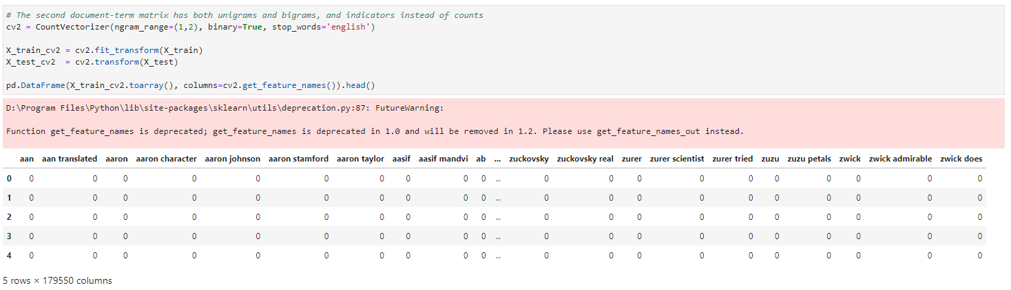
DIfferent NLP TechnIques – COUNT VECTORIZER

Slide 9
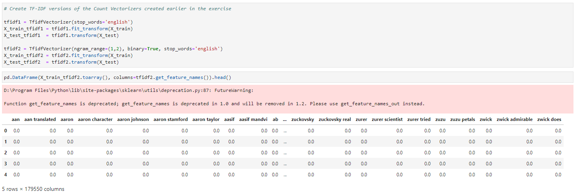
DIfferent NLP TechnIques – TF-IDF

Slide 10
Model Buıldıng & Evaluatıon
 | LogReg1 | LogReg2 | NB1 | NB2 | LR1-TFIDF | LR2-TFIDF | NB1-TFIDF | NB2-TFIDF
Accuracy | 0.765 | 0.800 | 0.758 | 0.595 | 0.795 | 0.742 | 0.668 | 0.595
Precision | 0.780 | 0.794 | 0.764 | 0.591 | 0.768 | 0.698 | 0.639 | 0.591
Recall | 0.833 | 0.889 | 0.846 | 1.000 | 0.932 | 0.987 | 0.991 | 1.000
F1 Score | 0.806 | 0.839 | 0.803 | 0.743 | 0.842 | 0.818 | 0.777 | 0.743

Slide 11
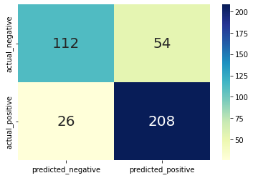
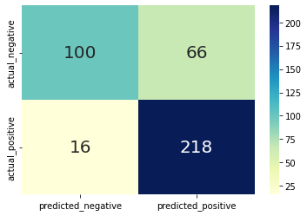
Two best model’s comparıson
Logistic Regression – Count Vectorizer with ngram
Logistic Regression – TF-IDF without ngram

Slide 12

Thank you !

